Slide 1
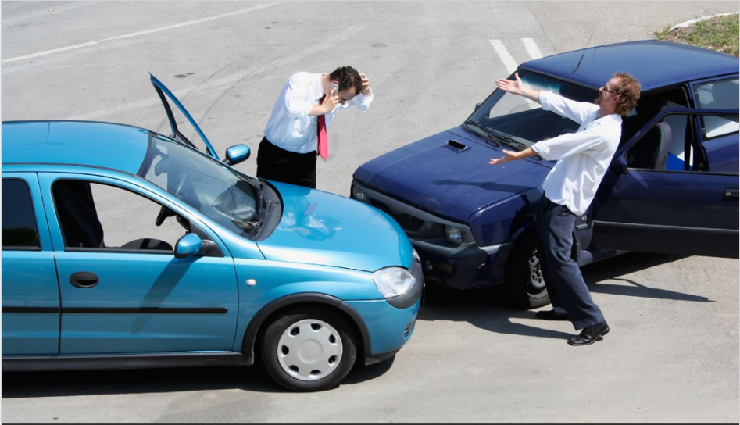
CHICAGO CAR CRASHES
By Noble, Lenore and Jakub
Notes:
Good Morning everyone,
Today we will be discussing classification models and inferences we made using data from Chicago Car Crashes

Slide 2

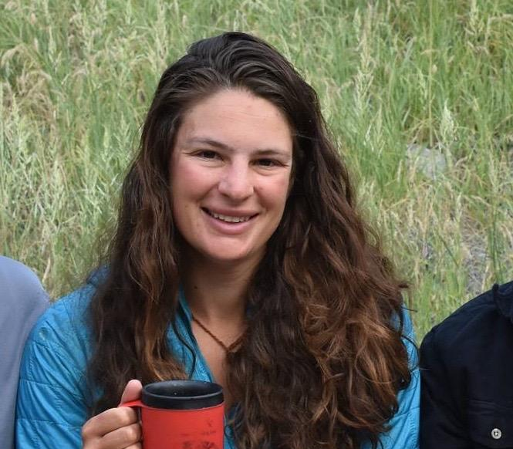

Intros
Noble Tang
Lenore Perconti
Jakub Rybicki
Data Scientist
Data Scientist
Data Scientist
Software Quality Operations
People and Talent Analyst
Geotechnical Engineer, MS
Notes:
A little about the team,
We have Noble, Lenore and myself, Jakub

Slide 3
Agenda
1
Business Understanding
2
Data Understanding and Preparation
3
Modeling
4
Evaluation
5
Proposal
6
Future Research
Notes:
Today we’re going to present
Our Stakeholder and their Interests
Our data and how we prepared it
Our Modeling Process
Evaluations we made from our model
Recommendations we drew from those evaluations
Discuss some factors to keep in mind for future analysis

Slide 4

Business
Understanding

Slide 5
City of Chicago, DOT Mission Statement
“Safe for users, environmentally sustainable, in a state of good repair and attractive.”
Business
Data
Modeling
Evaluation
Proposal
Future
Notes:
Stakeholder is Chicago DOT.
Prioritizes keeping roads safe and maintained
Set out to see if we could correctly classify car crashes in which the drivers were injured.
For the City of Chicago DOT, we set out to learn what factors contribute to night time traffic accidents resulting in injury
Severe traffic incidents we defined as FATAL + injury related from the INJURY_TYPE column.
Night we defined as the hours between 10pm to 6 am, or hours 22 through 6 in the CRASH_HOUR column.

Slide 6


What’s the Focus?
Night Time Crashes
Occurring between the hours of 10PM and 6AM
Crashes Resulting in Injury
Business
Data
Modeling
Evaluation
Proposal
Future
Notes:
Given the massive amount of data we had to work with, we decided to fine tune our focus for the City of Chicago DOT.
We set out to learn specifically what leads to night time traffic accidents resulting in the drive reporting some sort of injury
Hours of 10 pm - 6 am only words we need

Slide 7
Accidents Involving Injury at Night
87%
Accuracy
Road Condition
Device Condition
Lighting
Crash Day
Weather
Business
Data
Modeling
Evaluation
Proposal
Future
Notes:
When using Road Condition, Device Condition, Lighting, Crash Day and weather
our best model inferred accidents involving injury with an 87% accuracy.
Pass it along to Lenore to take us into data understanding and preparation.
BLUFF

Slide 8
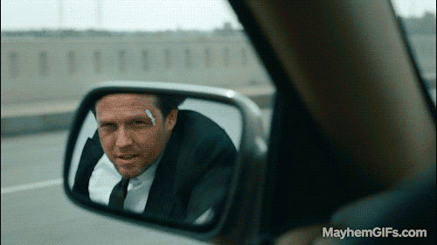
Data Understanding
and Preparation
Notes:
lenore

Slide 9
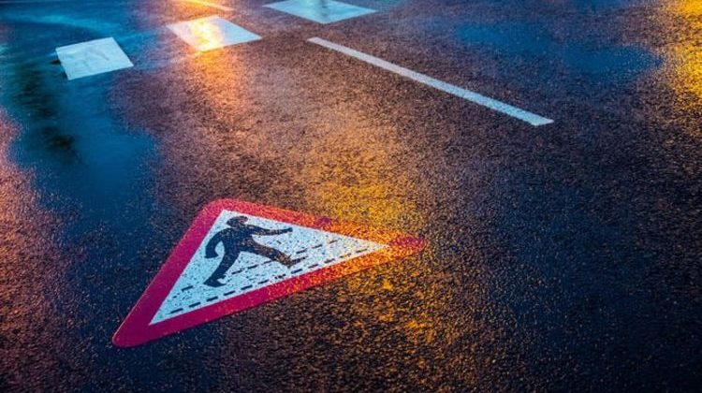
Vehicular conflicts in Chicago (2013 - Present)
Frequently updated data: 2013 - present
Two datasets - Crashes and People
Business
Data
Modeling
Evaluation
Proposal
Future

Slide 10
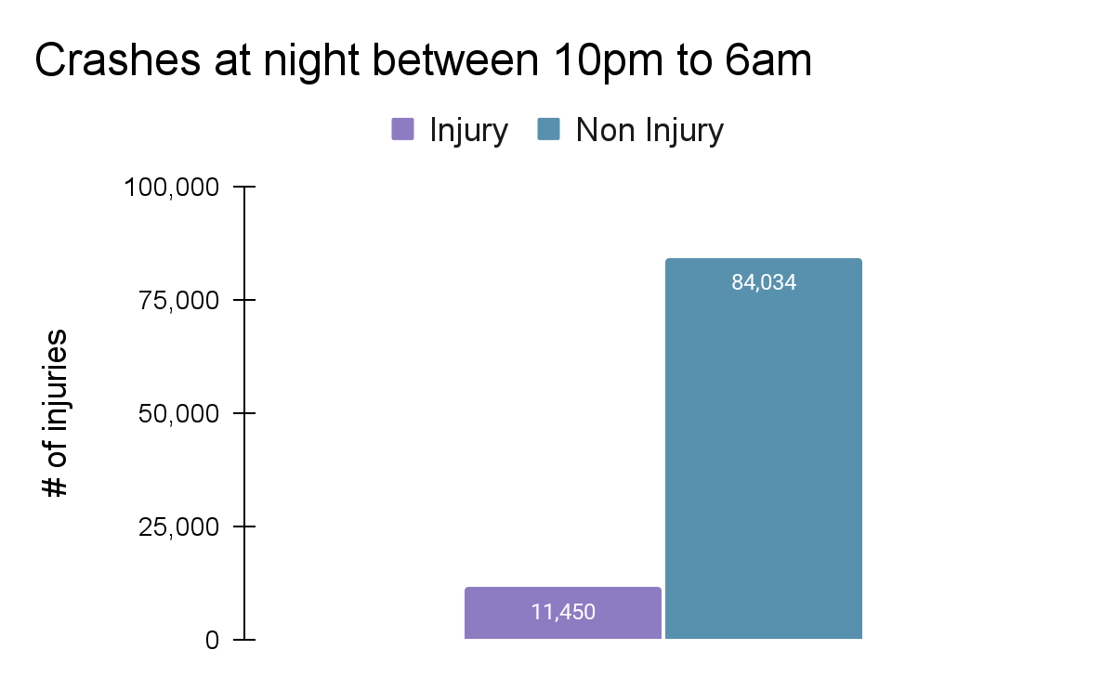
Business
Data
Modeling
Evaluation
Proposal
Future
Notes:
13%
Commas in counts

Slide 11
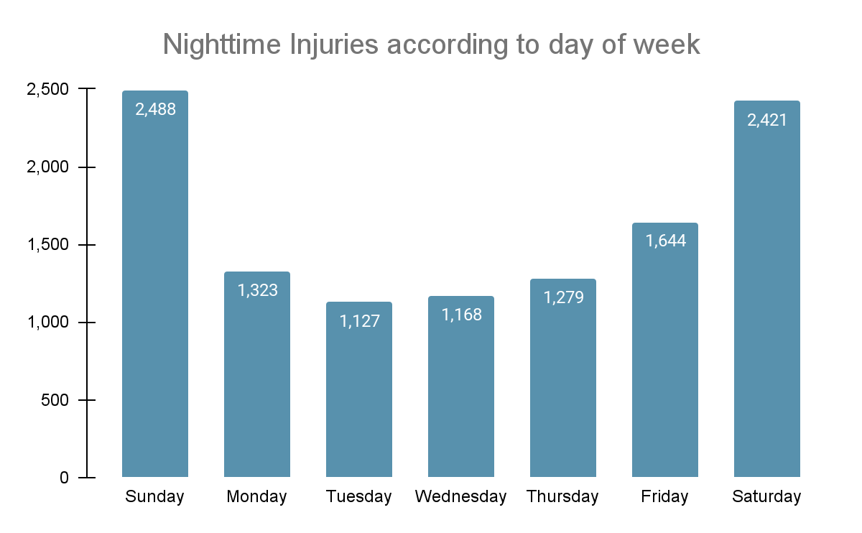
Business
Data
Modeling
Evaluation
Proposal
Future
Notes:
Change the x-axis labels
Bigger labels - add bar labels. Add callout around weekend. Spend more time on this graph.
Give some hypothesis on why this could be.

Slide 12
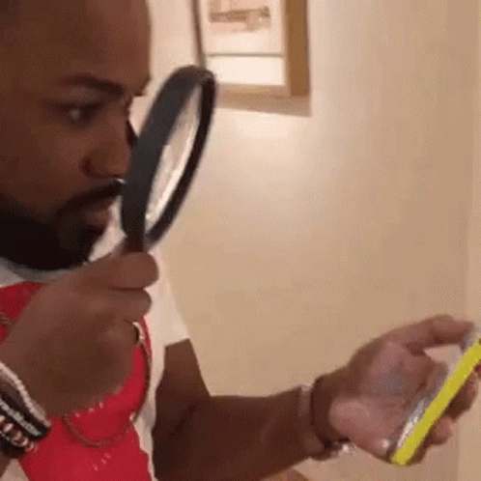
Modeling + Evaluation

Slide 13

Modeling Iterations
Traffic Control Device Condition
Weather Condition
Lighting Condition
Roadway Surface Condition
Crash Hour
Crash Day of Week
Injury Classification
Age
Blood alcohol content
Lighting
Road Conditions
Device Condition
Business
Data
Modeling
Evaluation
Proposal
Future
Notes:
Our team investigated several iterations of machine learning modeling.

Slide 14
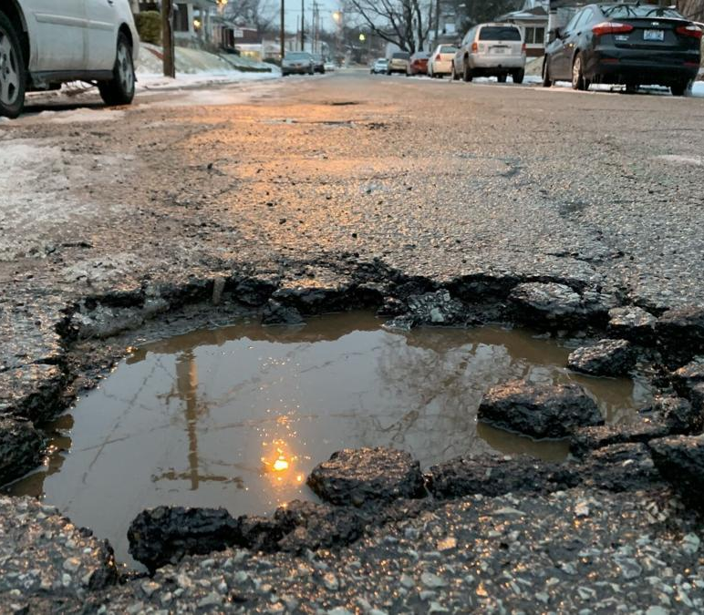
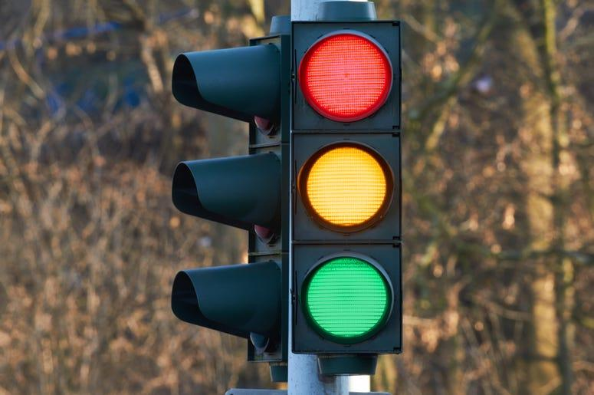
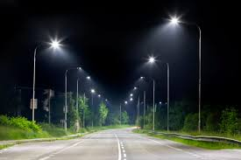
Top Features
1
2
3
Road Condition
Device Condition
Lighting
Business
Data
Modeling
Evaluation
Proposal
Future

Slide 15
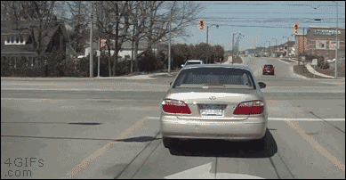
Proposal
Notes:
Noble

Slide 16

Conditions of the drive are more important than the driver
Business
Data
Modeling
Evaluation
Proposal
Future
Notes:
The model helped up infer that Conditions of the drive are actually more important than the driver and their actions.

Slide 17

Proposal
Mitigation efforts
Increased street lighting
Prioritize uptime of traffic devices
Business
Data
Modeling
Evaluation
Proposal
Future
Notes:
We know road condition is important in reducing traffic accidents. Potholes in the road should be filled quickly to avoid unsafe maneuvers. Roads need to be cleared of sand and dirt regularly to improve traction. Perhaps the city could introduce policies to reduce traffic speed when roads are wet
Headlights from the vehicle is not enough. Increasing the number of street lights on the road will allow drivers to better prepare for what’s ahead
Fixing traffic devices is very important. Lack of order on the roads will lead accidents that will result in injury
Decrease words put an icon

Slide 18
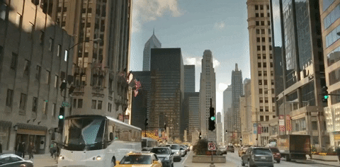
Further Research

Slide 19

Future Investigations
Location focused analysis
Incorporate DOT budget
Revisit Exploratory Data Analysis
Business
Data
Modeling
Evaluation
Proposal
Future
Notes:
We would look at location of these accidents to see if there are any underlying causes. Maybe there are blind corners at a specific intersection that lead to traffic accidents
Information about the department of transportation’s budget would also help tailor our recommendations.
Given more time, we would also investigate the traffic incidents that occurred during the day. Perhaps there are patterns that we could identify that would help further reduce injury in traffic accidents
Delete some words.

Slide 20

Noble Tang
github.com/nobletang
Thank You
Lenore
github.com/lperconti
Jakub Rybicki
github.com/Jakubryb

Slide 21
Questions?

Slide 22
Sources
Data from: https://data.cityofchicago.org/

Slide 23
Appendix

